Slide 1
SVM(Support Vector Machines)
Support vector machines is a form of supervised learning technique to solve classification problems
Find a best hyperplane which classify data set to different classes
Support vectors are the data points closest to the created hyperplane

Slide 2
Consider the data for determining the chances of travel, we determine the travel decision based on traffic and bus fare. if output yes travel is possible, and if no travel is not possible.
Traffic | Bus fare | Travel possibility
85 | 85 | No
60 | 70 | Yes
80 | 90 | No
72 | 95 | No
68 | 80 | Yes
74 | 73 | Yes
69 | 70 | Yes
75 | 85 | No
83 | 78 | No

Slide 3
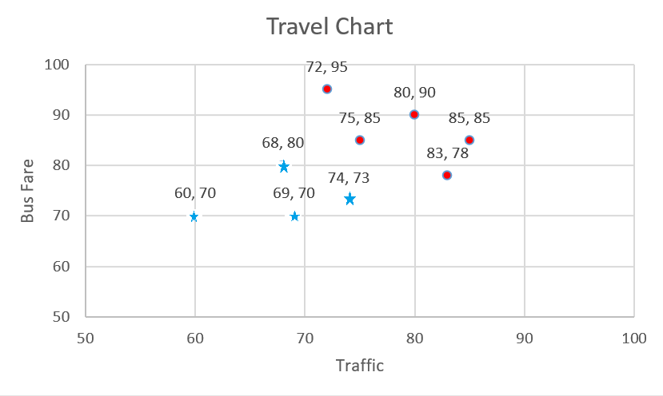

scatter plat of the above data
It is possible to draw a straight line in the scatter diagram to separate the values which produced an output $yes$and $no$.

Slide 4
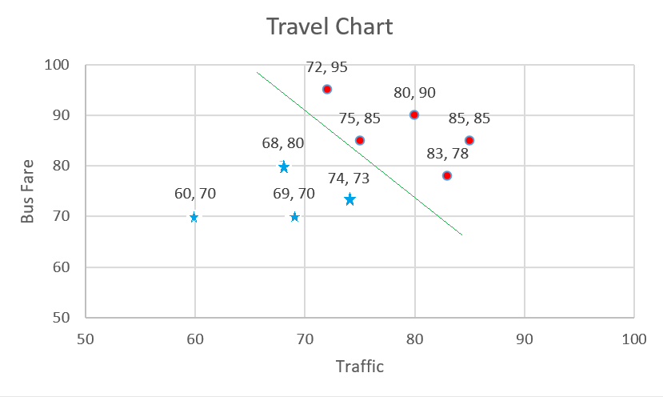
scatter plot with separator line

Slide 5
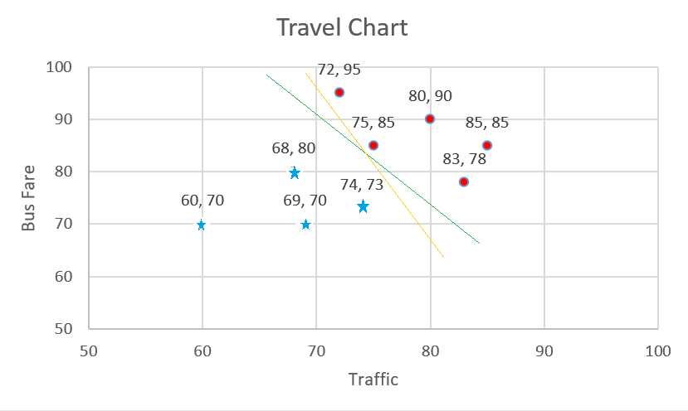
scatter plot with multiple separator line

Slide 6
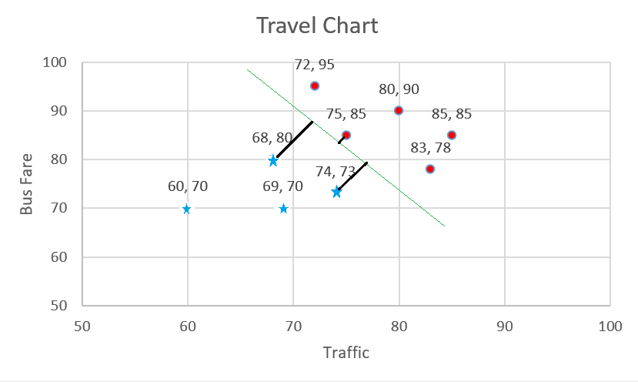
Margin: The margin of the separator line is defined as the double of the shortest perpendicular distance between data points and separator line.
Maximum Margin: The separator line with maximum margin can be considered as the best separator line and choose for classification.

Slide 7
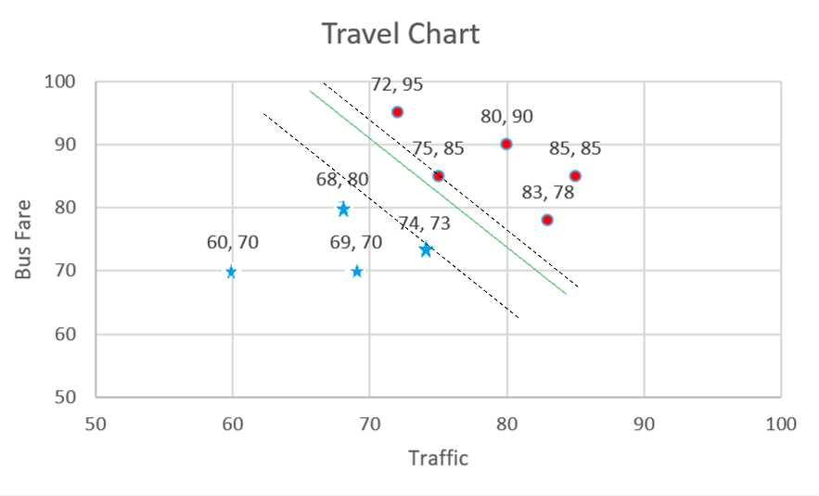
Dashed line through the nearest support vector of both classes as shown below
The region between these two dashed lines can be thought of as a “road” or a “street” of maximum width that separates the “yes” data points and the “no” data points.

Slide 8
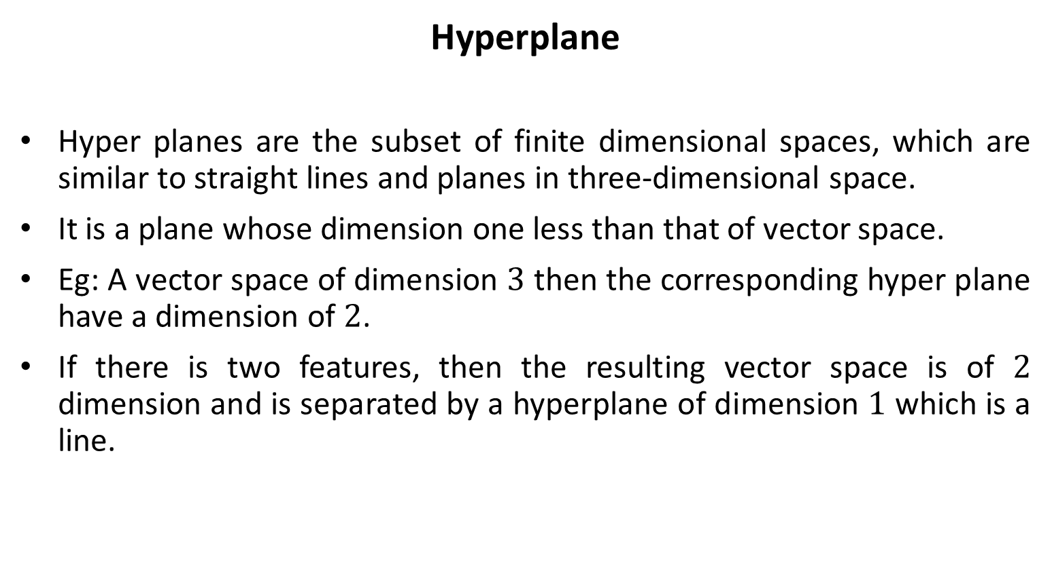
Hyperplane
Hyper planes are the subset of finite dimensional spaces, which are similar to straight lines and planes in three-dimensional space.
It is a plane whose dimension one less than that of vector space.
Eg: A vector space of dimension $3$ then the corresponding hyper plane have a dimension of $2$.
If there is two features, then the resulting vector space is of $2$ dimension and is separated by a hyperplane of dimension $1$ which is a line.

Slide 9
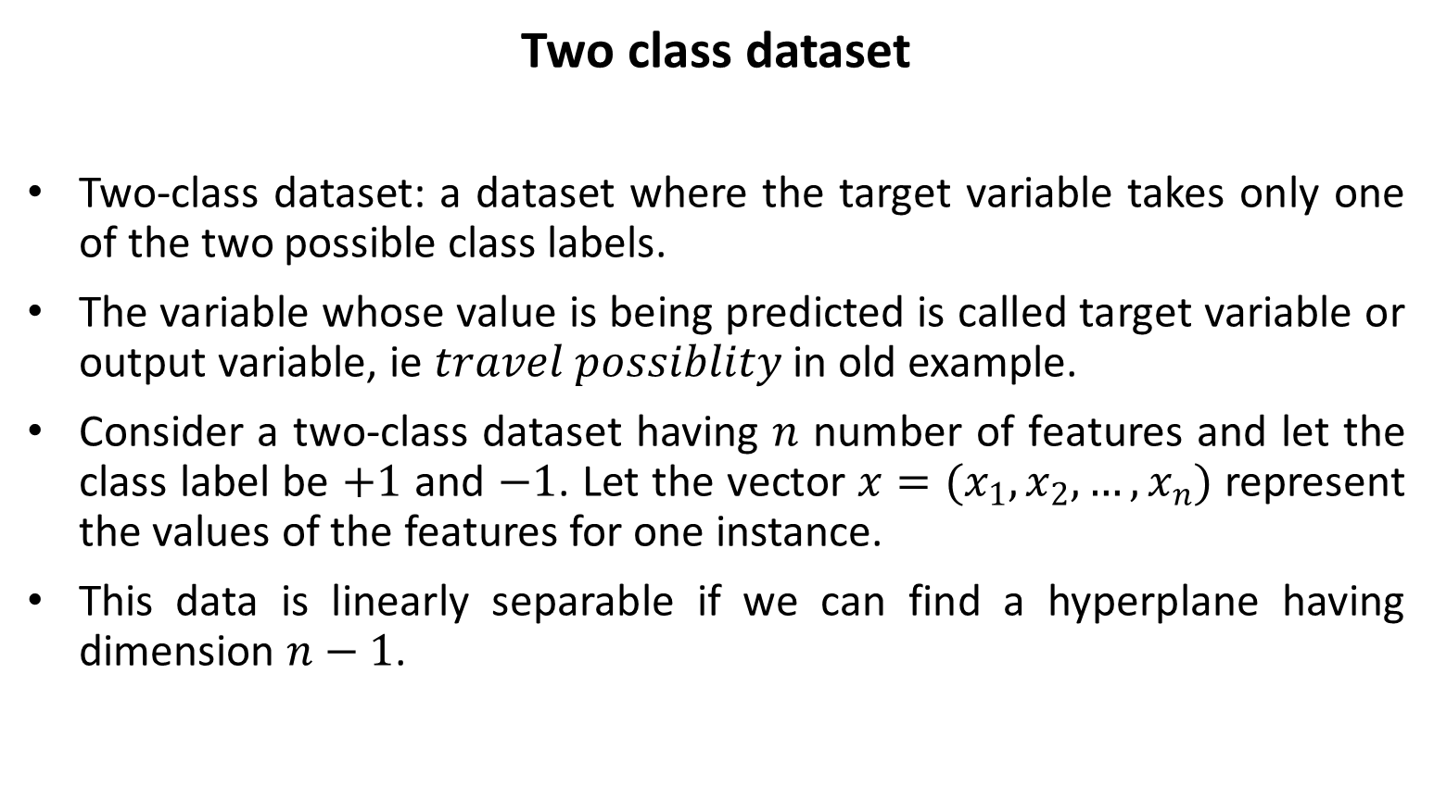
Two class dataset
Two-class dataset: a dataset where the target variable takes only one of the two possible class labels.
The variable whose value is being predicted is called target variable or output variable, ie $travel possiblity$ in old example.
Consider a two-class dataset having $n$ number of features and let the class label be $+1$ and $−1$. Let the vector $x=(x_{1},x_{2},…,x_{n})$ represent the values of the features for one instance.
This data is linearly separable if we can find a hyperplane having dimension $n−1$.

Slide 10

The hyper plane is given below
$$β_{0}+β_{1}x_{1}+β_{2}x_{2}+…+β_{n}x_{n}=0$$
Where
For each instance in $x$with class label $+1;$ $β_{0}+β_{1}x_{1}+β_{2}x_{2}+…+β_{n}x_{n}>0$
For each instance in $x$with class label $−1;$ $β_{0}+β_{1}x_{1}+β_{2}x_{2}+…+β_{n}x_{n}<0$

Slide 11
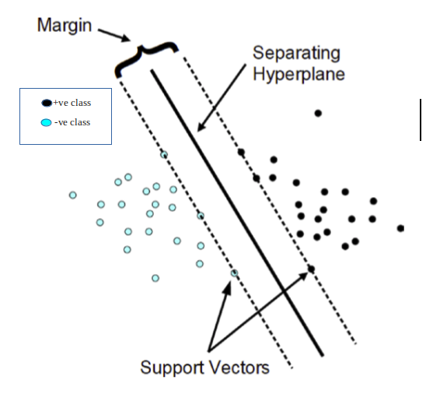
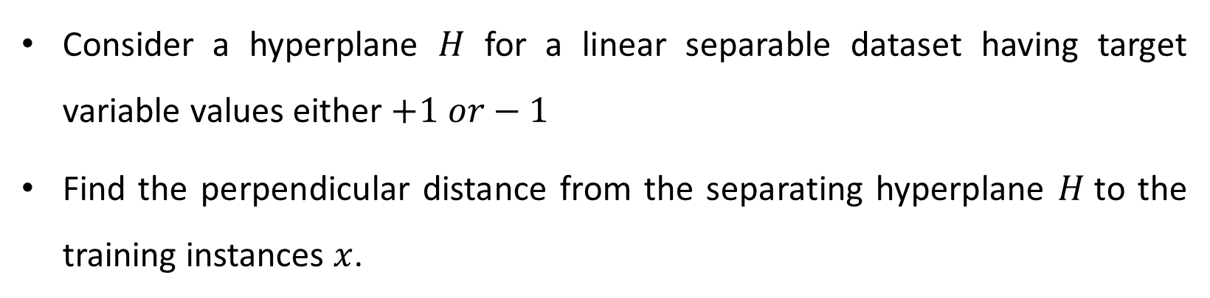
Maximal margin hyperplanes
Consider a hyperplane $H$ for a linear separable dataset having target variable values either $+1 or−1$
Find the perpendicular distance from the separating hyperplane $H$to the training instances $x$.

Slide 12

The double of the smallest perpendicular distance is called margin of the hyperplane $H.$
The hyperplane having maximum margin is called maximal margin hyperplane or optimal hyperplane.
The support vector machine for the dataset is said to be the maximal margin hyperplane and the data points that lies closest to the hyperplane is called support vectors.

Slide 13
Kernel SVM
Kernel SVM (Nonlinear SVM) came to the role when the data is not linearly separable.
SVM uses some mathematical functions as kernels to transform the input data in to a required format to transform nonlinearity in data to linearity.
There are different types of kernels used in SVM.

Slide 14
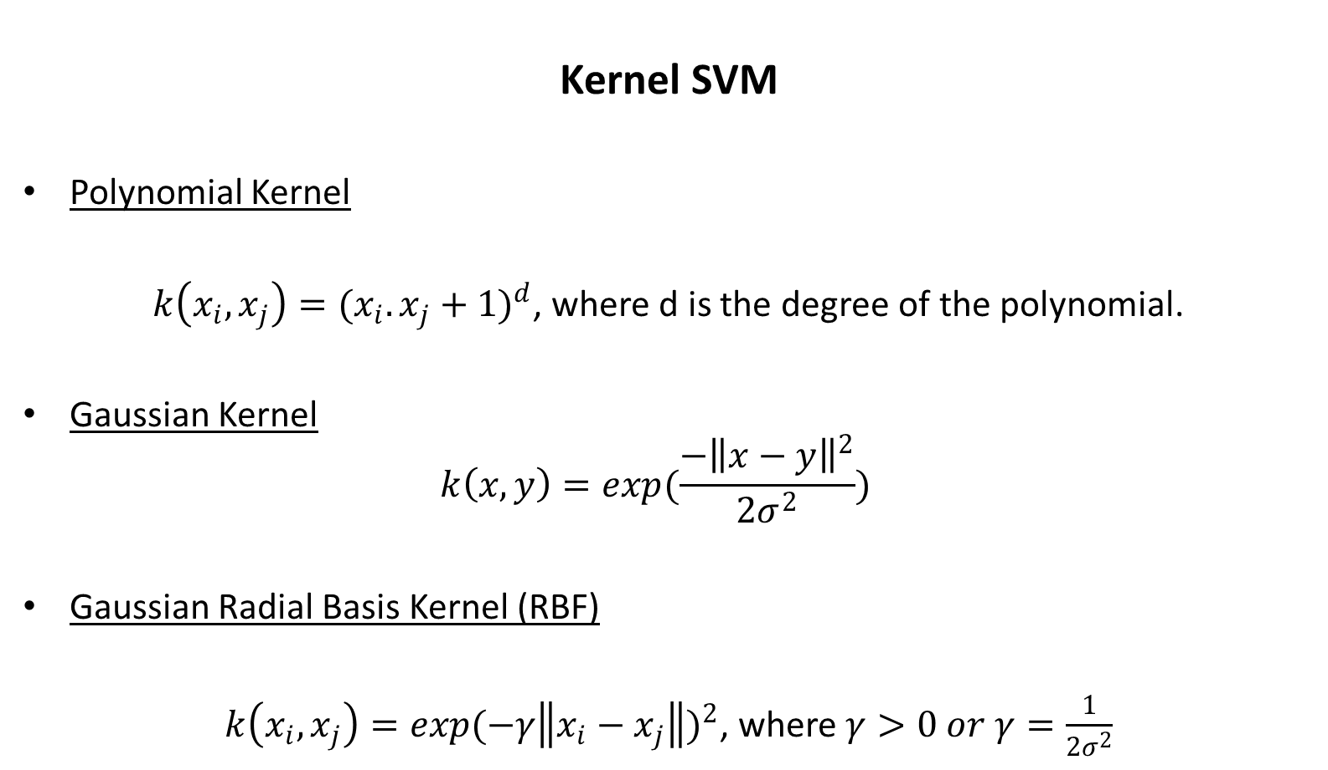
Kernel SVM
Polynomial Kernel
$k\left(x_{i},x_{j}\right)={(x_{i}.x_{j}+1)}^{d}$, where d is the degree of the polynomial.
Gaussian Kernel
$$k\left(x,y\right)={exp(\frac{−{\left\|x−y\right\|}^{2}}{2σ^{2}})}^{}$$
Gaussian Radial Basis Kernel (RBF)
$k\left(x_{i},x_{j}\right)={exp(−γ\left\|x_{i}−x_{j}\right\|)}^{2}$, where $γ>0 or γ=\frac{1}{2σ^{2}}$

Slide 15
SVM-ADVANTAGE
Works well if there is a clear margin of separation between classes
Applicable to higher dimensional data
Applicable even if the number of dimensions is greater than the number of samples.
Works with high memory efficiency.

Slide 16
SVM-DISADVANTAGE
SVM is not appropriate for the application on large datasets
SVM struggles when there is a presence of noise in the data
If number of features for each data point exceeds the number of training data samples, SVM suffers performance degradation
As the support vector classifier works by putting data points, above and below the classifying hyperplane there is no probabilistic explanation for the classification.

Slide 17
SVM-APPLICATIONS
Text Classification
Face Detection
Fingerprint Identification
Image classification
Handwriting recognition
Geo-spatial data-based applications
Security-based applications
Computational biology

Slide 18
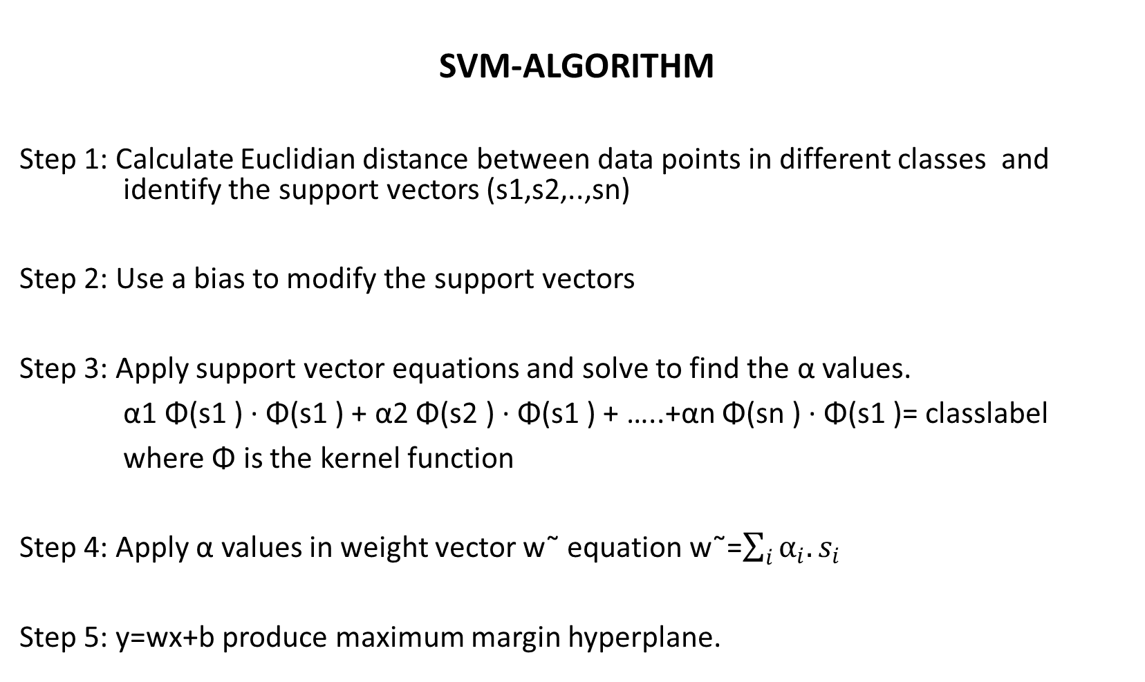
SVM-ALGORITHM
Step 1: Calculate Euclidian distance between data points in different classes and identify the support vectors (s1,s2,..,sn)
Step 2: Use a bias to modify the support vectors
Step 3: Apply support vector equations and solve to find the α values.
α1 Φ(s1 ) · Φ(s1 ) + α2 Φ(s2 ) · Φ(s1 ) + …..+αn Φ(sn ) · Φ(s1 )= classlabel
where Φ is the kernel function
Step 4: Apply α values in weight vector w˜ equation w˜=$\sum_{i}{α_{i}.s_{i}}$
Step 5: y=wx+b produce maximum margin hyperplane.

Slide 19
IRIS Data Set
This is the best known database to be found in the pattern recognition literature. IRIS data set is created by R.A. Fisher.
The data set contains 3 classes of 50 instances each, where each class refers to a type of iris plant.
One class is linearly separable from the other 2; the latter are NOT linearly separable from each other.
Predicted attribute: class of iris plant.

Slide 20
IRIS Data Set
Attribute Information:
1. sepal length in cm
2. sepal width in cm
3. petal length in cm
4. petal width in cm
5. class: Iris Setosa, Iris Versicolour, Iris Virginica

Slide 21
SVM Example- IRIS Data Set- Linear Separable Data
Problem: 5 samples from each classes in iris data set is selected find maximum marginal hyperplane separating these classes
Id | SepalLengthCm | SepalWidthCm | PetalLengthCm | PetalWidthCm | Species
SE1 | 5.1 | 3.5 | 1.4 | 0.2 | Iris-setosa
SE2 | 4.9 | 3 | 1.4 | 0.2 | Iris-setosa
SE3 | 4.7 | 3.2 | 1.3 | 0.2 | Iris-setosa
SE4 | 4.6 | 3.1 | 1.5 | 0.2 | Iris-setosa
SE5 | 5 | 3.6 | 1.4 | 0.2 | Iris-setosa
VE1 | 7 | 3.2 | 4.7 | 1.4 | Iris-versicolor
VE2 | 6.4 | 3.2 | 4.5 | 1.5 | Iris-versicolor
VE3 | 6.9 | 3.1 | 4.9 | 1.5 | Iris-versicolor
VE4 | 5.5 | 2.3 | 4 | 1.3 | Iris-versicolor
VE5 | 6.5 | 2.8 | 4.6 | 1.5 | Iris-versicolor
VI1 | 6.3 | 3.3 | 6 | 2.5 | Iris-virginica
VI2 | 5.8 | 2.7 | 5.1 | 1.9 | Iris-virginica
VI3 | 7.1 | 3 | 5.9 | 2.1 | Iris-virginica
VI4 | 6.3 | 2.9 | 5.6 | 1.8 | Iris-virginica
VI5 | 6.5 | 3 | 5.8 | 2.2 | Iris-virginica

Slide 22
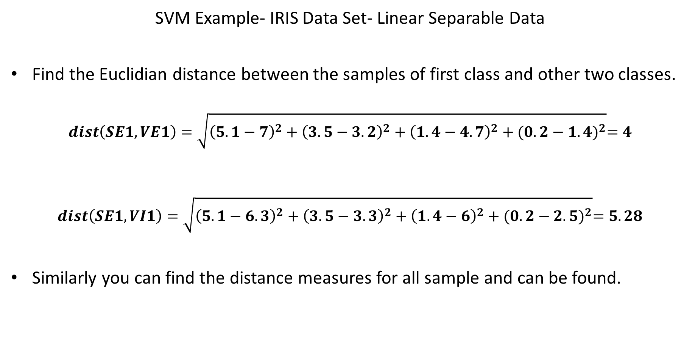
SVM Example- IRIS Data Set- Linear Separable Data
Find the Euclidian distance between the samples of first class and other two classes.
$$dist\left(SE1,VE1\right)=\sqrt{{\left(5.1−7\right)}^{2}+{\left(3.5−3.2\right)}^{2}+{\left(1.4−4.7\right)}^{2}+{(0.2−1.4)}^{2}}=4$$
$$dist\left(SE1,VI1\right)=\sqrt{{\left(5.1−6.3\right)}^{2}+{\left(3.5−3.3\right)}^{2}+{\left(1.4−6\right)}^{2}+{(0.2−2.5)}^{2}}=5.28$$
Similarly you can find the distance measures for all sample and can be found.

Slide 23
SVM Example- IRIS Data Set- Linear Separable Data
As we calculate the determinant of these distance matrices, we get a non-zero value and hence the data is linearly separable.
 | VE1 | VE2 | VE3 | VE4 | VE5
SE1 | 4 | 3.62 | 4.16 | 3.09 | 3.79
SE2 | 4.1 | 3.69 | 4.24 | 2.98 | 3.81
SE3 | 4.28 | 3.85 | 4.42 | 3.15 | 4
SE4 | 4.18 | 3.73 | 4.31 | 2.98 | 3.87
SE5 | 4.06 | 3.66 | 4.22 | 3.15 | 3.85
 | VI1 | VI2 | VI3 | VI4 | VI5
SE1 | 5.28 | 4.21 | 5.3 | 4.69 | 5.06
SE2 | 5.34 | 4.18 | 5.36 | 4.71 | 5.09
SE3 | 5.47 | 4.33 | 5.53 | 4.87 | 5.25
SE4 | 5.34 | 4.18 | 5.41 | 4.72 | 5.11
SE5 | 5.31 | 4.25 | 5.35 | 4.73 | 5.1

Slide 24
SVM Example- IRIS Data Set- Linear Separable Data
In order to find the support vectors find the points having minimal Euclidian distance. And those points are highlighted in below table
 | VE1 | VE2 | VE3 | VE4 | VE5
SE1 | 4 | 3.62 | 4.16 | 3.09 | 3.79
SE2 | 4.1 | 3.69 | 4.24 | 2.98 | 3.81
SE3 | 4.28 | 3.85 | 4.42 | 3.15 | 4
SE4 | 4.18 | 3.73 | 4.31 | 2.98 | 3.87
SE5 | 4.06 | 3.66 | 4.22 | 3.15 | 3.85

Slide 25
SVM Example- IRIS Data Set- Linear Separable Data
The support vectors for setosa and versicolor are (SE2, SE4, VE4)
    S1=SE2=[4.9, 3, 1.4, 0.2]
    S2=SE4=[4.6, 3.1, 1.5, 0.2]
    S3=VE4=[5.5, 2.3, 4, 1.3]
Now assume bias as 1 and the support vectors are changed to
  S1=SE2=[4.9, 3, 1.4, 0.2, 1]
  S2=SE4=[4.6, 3.1, 1.5, 0.2, 1]
  S3=VE4=[5.5, 2.3, 4, 1.3, 1]

Slide 26
SVM Example- IRIS Data Set- Linear Separable Data
As you have changed support vectors you can now start writing support vector equations which maximises the margin. The equation is given below. (assume class label for setosa = -1 and versicolor = +1)
α1 Φ(s1 ) · Φ(s1 ) + α2 Φ(s2 ) · Φ(s1 ) + α3 Φ(s3 ) · Φ(s1 ) = −1
α1 Φ(s1 ) · Φ(s2 ) + α2 Φ(s2 ) · Φ(s2 ) + α3 Φ(s3 ) · Φ(s2 ) = -1
α1 Φ(s1 ) · Φ(s3 ) + α2 Φ(s2 ) · Φ(s3 ) + α3 Φ(s3 ) · Φ(s3 ) = +1

Slide 27
SVM Example- IRIS Data Set- Linear Separable Data
Since the problem is linearly separable Φ()= Identity , so the above equation reduces to
α1 s˜1 · s˜1 + α2 s˜2 · s˜1 + α3 s˜3 · s˜1 = −1
α1 s˜1 · s˜2 + α2 s˜2 · s˜2 + α3 s˜3 · s˜2 = -1
α1 s˜1 · s˜3 + α2 s˜2 · s˜3 + α3 s˜3 · s˜3 = +1
Since the problem is linearly separable Φ()= Identity , so the above equation reduces to
s˜1 · s˜1 = [4.9, 3, 1.4, 0.2, 1] . [4.9, 3, 1.4, 0.2, 1]= 4.9*4.9 + 3*3 + 1.4*1.4 + 0.2*0.2 + 1*1=36

Slide 28
SVM Example- IRIS Data Set- Linear Separable Data
Similarly find the dot products and substitute in the above equation to obtain.
36α1 + 35α2 + 41α3 = −1
35α1 + 34α2 + 40α3 = -1
41α1 + 40α2 + 54α3 = +1
Solving the above equation results in α1= -2.5, α2= 2.25 and α3= 0.25

Slide 29
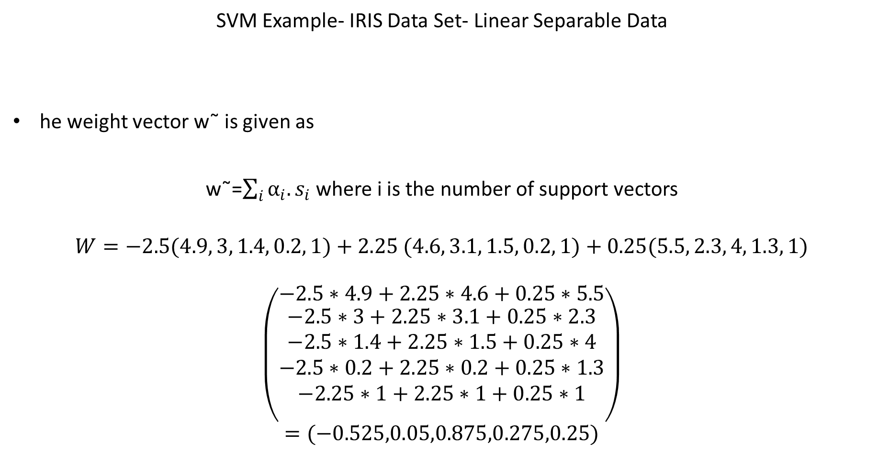
SVM Example- IRIS Data Set- Linear Separable Data
he weight vector w˜ is given as
w˜=$\sum_{i}{α_{i}.s_{i}}$where i is the number of support vectors
$$W=−2.5(4.9, 3, 1.4, 0.2, 1)+2.25 (4.6, 3.1, 1.5, 0.2, 1)+0.25(5.5, 2.3, 4, 1.3, 1)$$
$$\left({−2.5∗4.9+2.25∗4.6+0.25∗5.5 \atop \begin{aligned}−2.5∗3+2.25∗3.1+0.25∗2.3 \\ −2.5∗1.4+2.25∗1.5+0.25∗4 \\ −2.5∗0.2+2.25∗0.2+0.25∗1.3 \\ −2.25∗1+2.25∗1+0.25∗1 \\ \end{aligned}}\right)$$
$$=(−0.525,0.05,0.875,0.275,0.25)$$

Slide 30
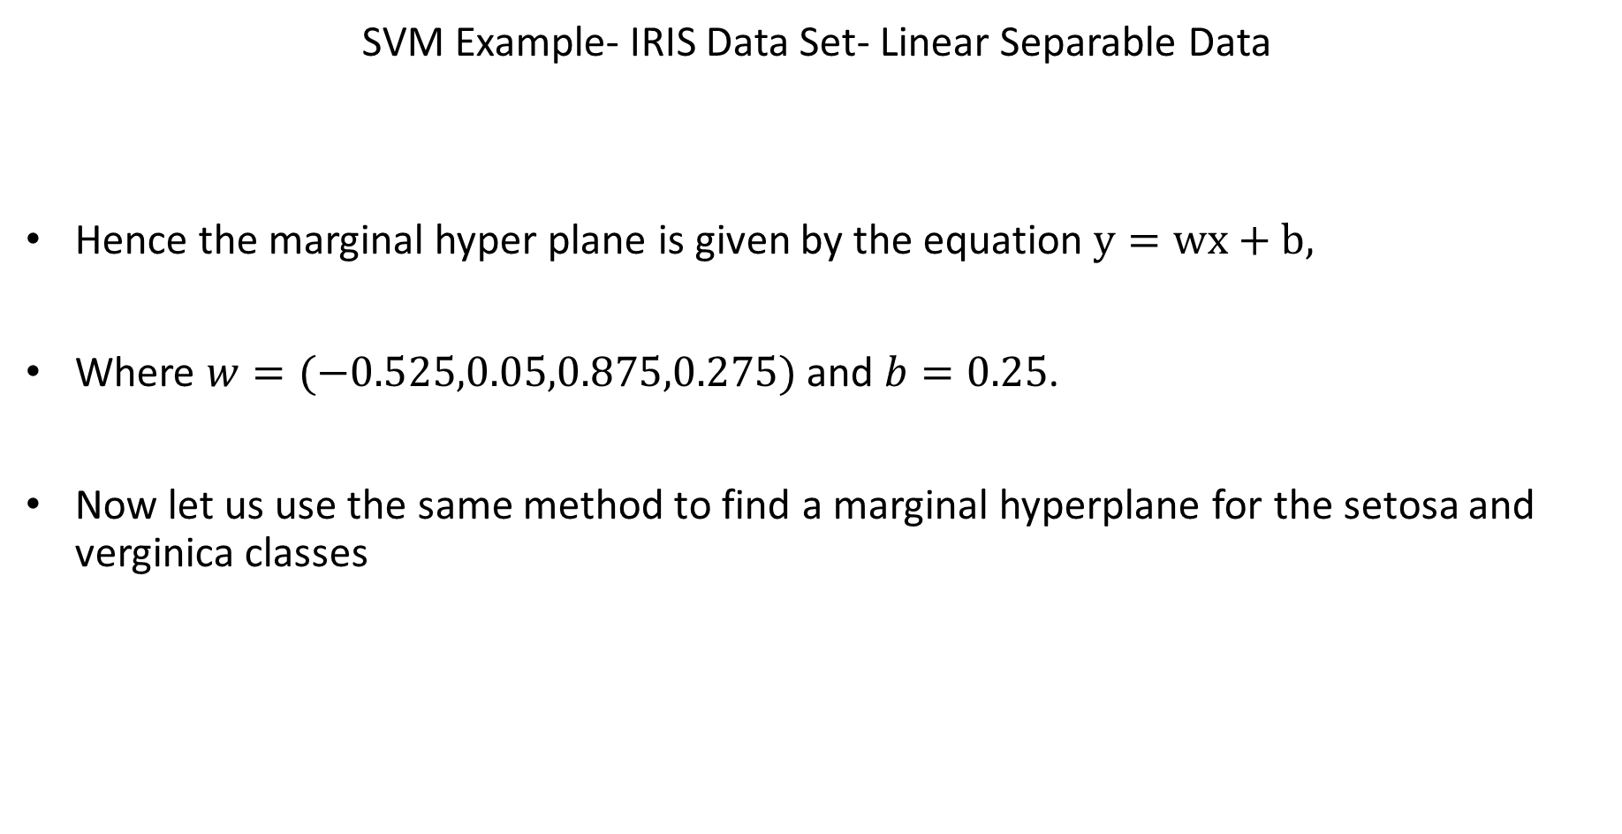
SVM Example- IRIS Data Set- Linear Separable Data
Hence the marginal hyper plane is given by the equation $y=wx+b,$
Where $w=(−0.525,0.05,0.875,0.275)$ and $b=0.25$.
Now let us use the same method to find a marginal hyperplane for the setosa and verginica classes

Slide 31
SVM Example- IRIS Data Set- Linear Separable Data
The support vectors for setosa and virginica are (SE1, SE2, SE4, VI2)
  S1=SE1=[5.1, 3.5, 1.4, 0.2]
  S2=SE2=[4.9, 3, 1.4, 0.2]
  S3=SE4=[4.6, 3.1, 1.5, 0.2]
  S4=VI2=[5.8, 2.7, 5.1, 1.9]
 | VI1 | VI2 | VI3 | VI4 | VI5
SE1 | 5.28 | 4.18 | 5.3 | 4.69 | 5.06
SE2 | 5.34 | 4.18 | 5.36 | 4.71 | 5.09
SE3 | 5.47 | 4.33 | 5.53 | 4.87 | 5.25
SE4 | 5.34 | 4.18 | 5.41 | 4.72 | 5.11
SE5 | 5.31 | 4.25 | 5.35 | 4.73 | 5.1

Slide 32
SVM Example- IRIS Data Set- Linear Separable Data
Add bias to support vectors and assume class label for setosa = -1 and virginica = +1
41α1 + 38α2 + 37α3+ 48α4 = −1
38α1 + 36α2 + 35α3+ 45α4 = -1
37α1 + 35α2 + 34α3+ 44α4 = -1
48α1 + 45α2 + 44α3+ 72α4 = +1
Solving the above equation results in α1= -0.11, α2= -1.82 , α3= 1.82 and α3= 0.11

Slide 33
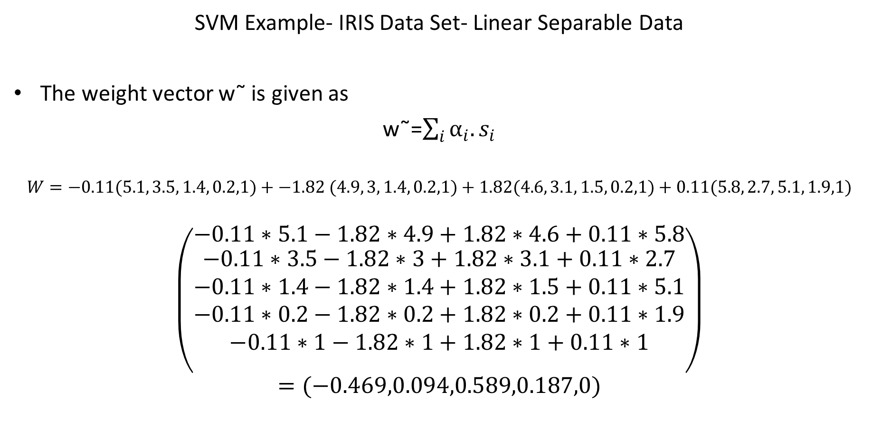
SVM Example- IRIS Data Set- Linear Separable Data
The weight vector w˜ is given as
w˜=$\sum_{i}{α_{i}.s_{i}}$
$$W=−0.11(5.1, 3.5, 1.4, 0.2,1)+−1.82 (4.9, 3, 1.4, 0.2,1)+1.82(4.6, 3.1, 1.5, 0.2,1)+0.11(5.8, 2.7, 5.1, 1.9,1)$$
$$\left({−0.11∗5.1−1.82∗4.9+1.82∗4.6+0.11∗5.8 \atop \begin{aligned}−0.11∗3.5−1.82∗3+1.82∗3.1+0.11∗2.7 \\ −0.11∗1.4−1.82∗1.4+1.82∗1.5+0.11∗5.1 \\ −0.11∗0.2−1.82∗0.2+1.82∗0.2+0.11∗1.9 \\ −0.11∗1−1.82∗1+1.82∗1+0.11∗1 \\ \end{aligned}}\right)$$
$$=(−0.469,0.094,0.589,0.187,0)$$

Slide 34

SVM Example- IRIS Data Set- Linear Separable Data
Hence the marginal hyper plane is given by the equation $y=wx+b$
Where $w=(−0.469,0.094,0.589,0.187)$ and $b=0$

Slide 35
SVM Example- IRIS Data Set- Non Linear Separable Data
Id | SepalLengthCm | SepalWidthCm | PetalLengthCm | PetalWidthCm | Species
VE1 | 7 | 3.2 | 4.7 | 1.4 | Iris-versicolor
VE2 | 6.4 | 3.2 | 4.5 | 1.5 | Iris-versicolor
VE3 | 6.9 | 3.1 | 4.9 | 1.5 | Iris-versicolor
VE4 | 5.5 | 2.3 | 4 | 1.3 | Iris-versicolor
VE5 | 6.5 | 2.8 | 4.6 | 1.5 | Iris-versicolor
VI1 | 6.3 | 3.3 | 6 | 2.5 | Iris-virginica
VI2 | 5.8 | 2.7 | 5.1 | 1.9 | Iris-virginica
VI3 | 7.1 | 3 | 5.9 | 2.1 | Iris-virginica
VI4 | 6.3 | 2.9 | 5.6 | 1.8 | Iris-virginica
VI5 | 6.5 | 3 | 5.8 | 2.2 | Iris-virginica

Slide 36
FSVM Example- IRIS Data Set- Linear Separable Data
Step 1: Calculate the Euclidian distance between each sample in versicolor with samples in virginica
Step 2: Check if the data is linearly separable by finding the determinant of distance matrix found in step 1
The above given data is not linearly separable, hence we need proceed with nonlinear SVM.
Step 3: Convert the samples to linearly separable data by applying appropriate kernel function. (kernel functions are mentioned in introduction section)
Step4: Now the data is linearly seperable and continue the procedure for linearly separable data as discussed above,

Slide 37
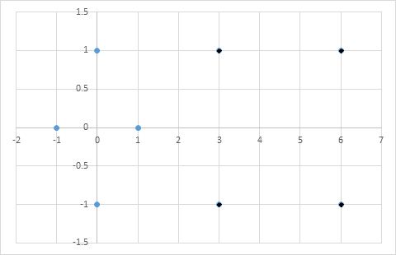
Further Simplified SVM Example- Linear Separable Data
Problem: Consider the dataset having values (3,1), (3,-1),(6,1),(6,-1) mapped to the positive class and (1,0),(0,1),(0,-1),(-1,0) mapped to negative class. Find the best line that separate these points.
Solution:
Plot the points to the graph and find the support vectors

Slide 38
Black denotes positive class points and blue denotes negative class points.
From the graph, it is clear that the support vectors are s1=(1,0) s2=(3,1) and s3=(3,-1)
Now assume bias as 1 and the support vectors changed to s1=(1,0,1) s2=(3,1,1) and s3=(3,-1,1)
Given support vector equations which maximises the margin.
α1 Φ(s1 ) · Φ(s1 ) + α2 Φ(s2 ) · Φ(s1 ) + α3 Φ(s3 ) · Φ(s1 ) = −1
α1 Φ(s1 ) · Φ(s2 ) + α2 Φ(s2 ) · Φ(s2 ) + α3 Φ(s3 ) · Φ(s2 ) = +1
α1 Φ(s1 ) · Φ(s3 ) + α2 Φ(s2 ) · Φ(s3 ) + α3 Φ(s3 ) · Φ(s3 ) = +1

Slide 39
Since the problem is linearly separable Φ()= Identity, so the above equation reduces to
α1 s˜1 · s˜1 + α2 s˜2 · s˜1 + α3 s˜3 · s˜1 = −1
α1 s˜1 · s˜2 + α2 s˜2 · s˜2 + α3 s˜3 · s˜2 = +1
α1 s˜1 · s˜3 + α2 s˜2 · s˜3 + α3 s˜3 · s˜3 = +1
Substitute the values of support vectors
2α1 + 4α2 + 4α3 = −1
4α1 + 11α2 + 9α3 = +1
4α1 + 9α2 + 11α3 = +1
Solve these equations to find α1= -3.5, α2=0.75 and α3= 0.75

Slide 40

The weight vector w˜ is given as
w˜=$\sum_{i}{α_{i}.s_{i}}$
As per the equation w˜= -3.5(1,0,1)+0.75(3,1,1)+0.75(3,-1,1)=(1,0,-2)
y=wx+b, where w=(1,0) and b= -2.
Now you may plot the hyperplane

Slide 41
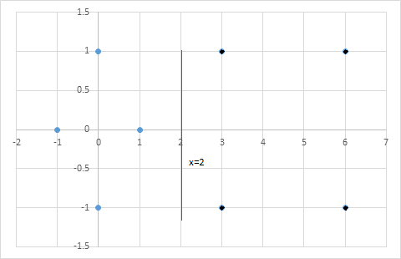
Plotting hyperplane

Slide 42
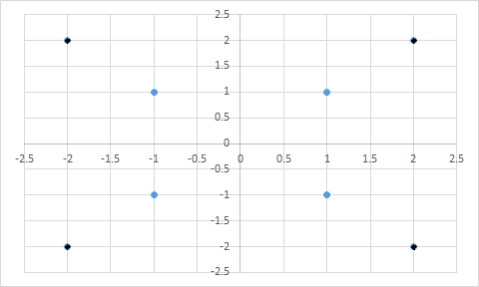
Further Simplified SVM Example- Nonlinear Data
Problem: Consider the dataset having values (2,2), (2,-2),(-2,-2),(-2,2) mapped to the positive class and (1,1),(1,-1),(-1,-1),(-1,1) mapped to negative class. Find the best line that separate these points.
Solution:
Plot the points to the graph and find the support vectors

Slide 43
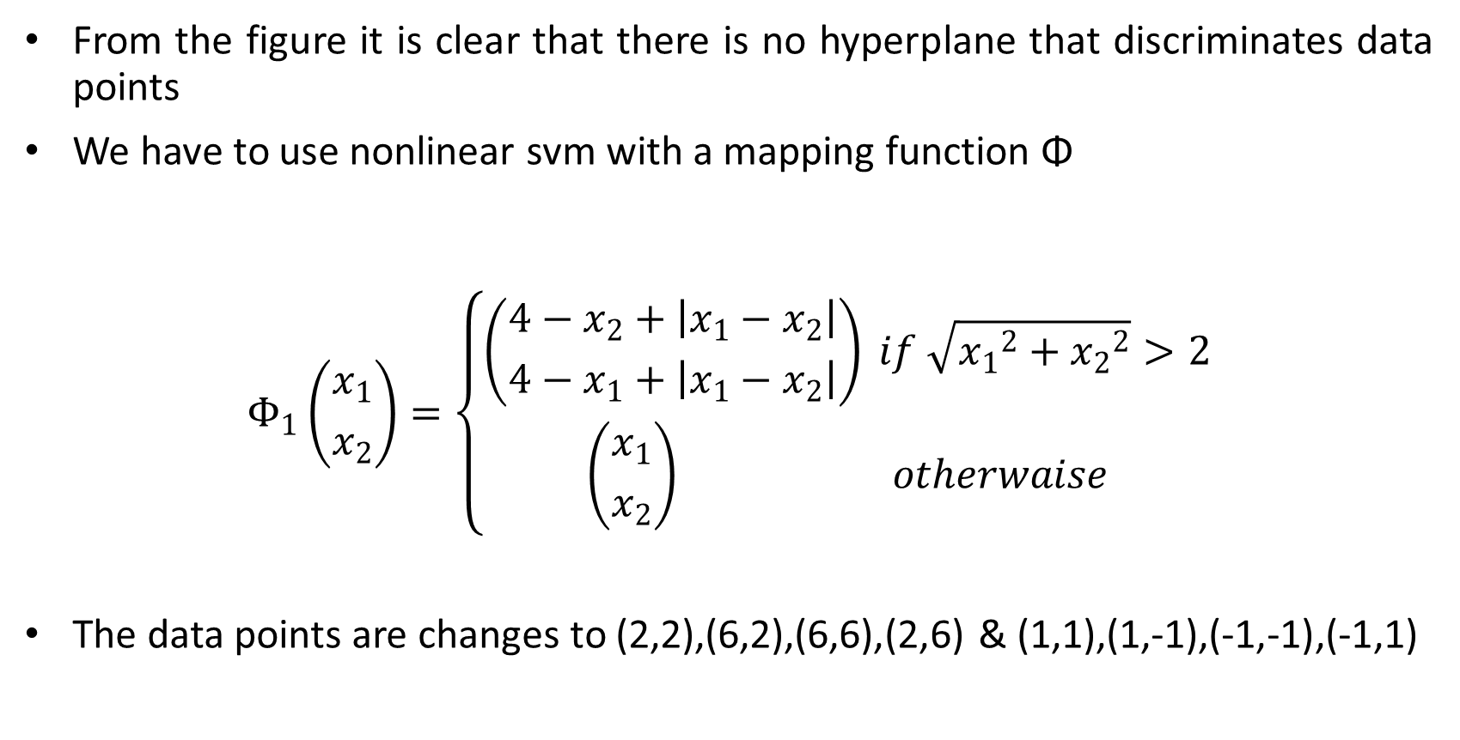
From the figure it is clear that there is no hyperplane that discriminates data points
We have to use nonlinear svm with a mapping function Φ
$$Φ_{1}\left({x_{1} \atop x_{2}}\right)=\left\{\begin{aligned}\left({4−x_{2}+\left|x_{1}−x_{2}\right| \atop 4−x_{1}+\left|x_{1}−x_{2}\right|}\right) if \sqrt{{x_{1}}^{2}+{x_{2}}^{2}}>2 \\ \left({x_{1} \atop x_{2}}\right) otherwaise\end{aligned}\right.$$
The data points are changes to (2,2),(6,2),(6,6),(2,6) & (1,1),(1,-1),(-1,-1),(-1,1)

Slide 44
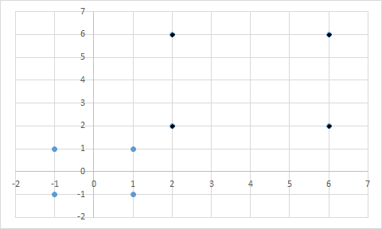
The graph for the transformed points is given below and are separable
Support vectors are s1=(1,1) and s2=(2,2)

Slide 45
Now as per the svm equation
α1 Φ(s1 ) · Φ(s1 ) + α2 Φ(s2 ) · Φ(s1 ) = −1
α1 Φ(s1 ) · Φ(s2 ) + α2 Φ(s2 ) · Φ(s2 ) = +1
Since the problem is linearly separable Φ()= Identity, so the above equation reduces to
α1 s˜1 · s˜1 + α2 s˜2 · s˜1 = −1
α1 s˜1 · s˜2 + α2 s˜2 · s˜2 = +1
Substitute the values of support vectors
3α1 + 5α2 = −1
5α1 + 9α2 = +1
Solving the above equation results in α1= -7, α2=4

Slide 46

The weight vector w˜ is given as
w˜=$\sum_{i}{α_{i}.s_{i}}$
As per the equation w˜= -7(1,1,1)+4(2,2,1) =(1,1,-3)
y=wx+b, where w=(1,1) and b= -3.
Now you can plot the marginal hyper plane

Slide 47
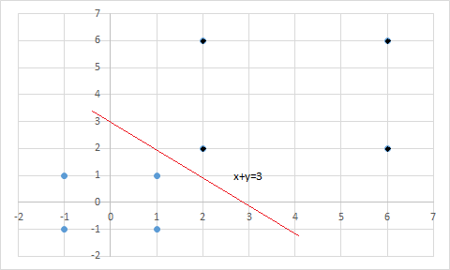
Plotting hyperplane

